Slide 1


Testing and Refactoring Node.js

Slide 2
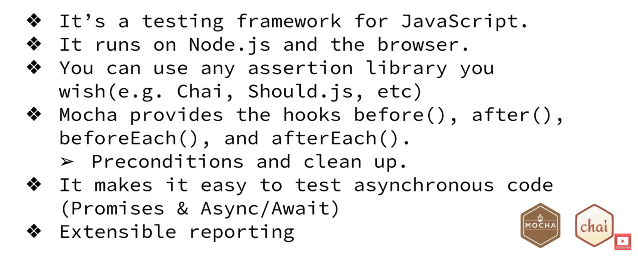
Node.js Testing Frameworks
What is Mocha?

Slide 3
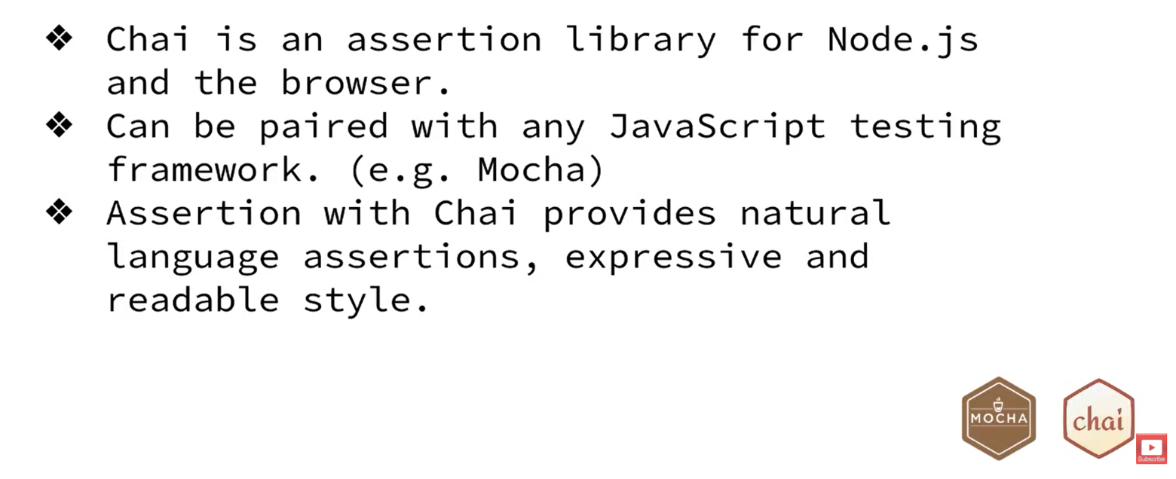
Node.js Testing Frameworks
What is Chai?

Slide 4
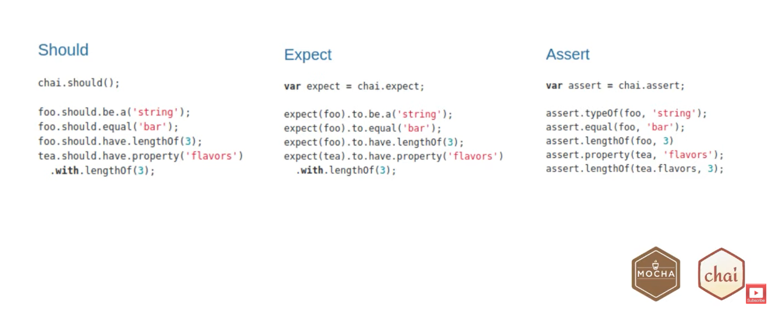
Node.js Testing Frameworks
Chai assertion styles

Slide 5

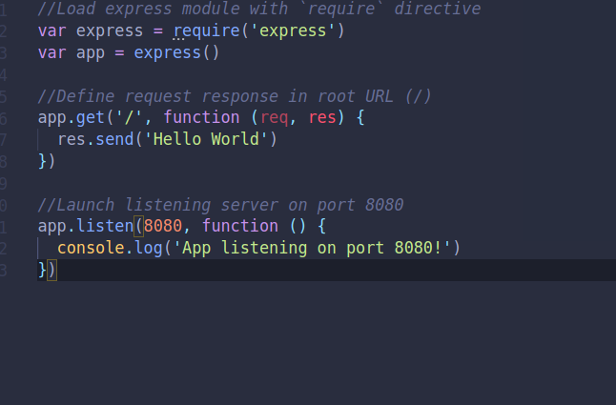
Node.js Testing Frameworks
npm i mocha
Update your scripts in package.json file
Write the back end code for your express app
Notes:
1:
Your scripts element of the package.json file should be updated to show how to run tests. We specify that Mocha will be used as shown below. Mocha will by default treat all JavaScript files in the ‘test’ directory of the app (see the next step) as tests. Therefore, adding this script to your package.json file allows you to run any tests you create in the test directory by typing “npm test” in the command line interface.
2:
Mocha will automatically treat all JavaScript files in this directory as tests. Create a file called ‘users.test.js’ in this directory that will test that the default functionality created for URL http://localhost:3000/users works as expected.

Slide 6
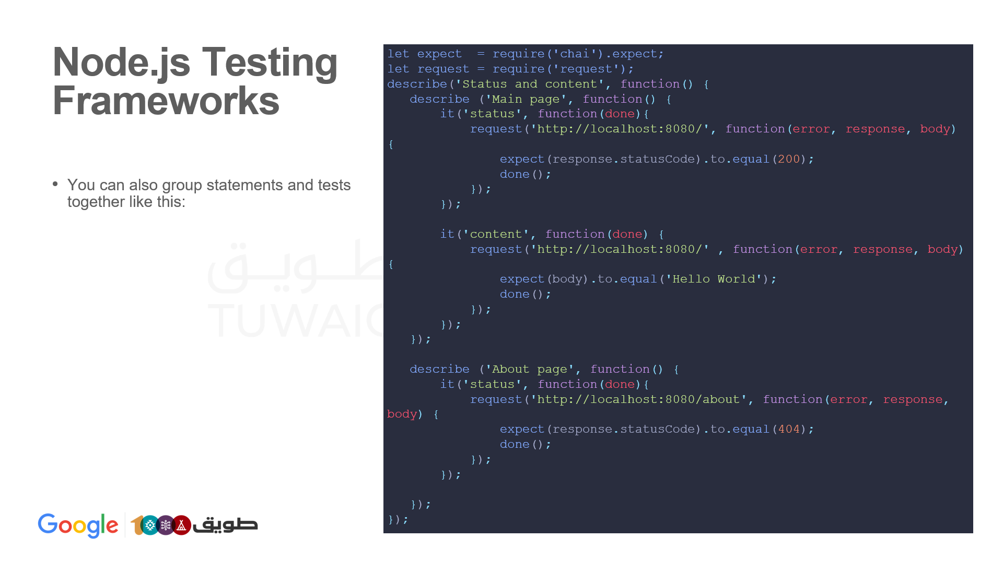
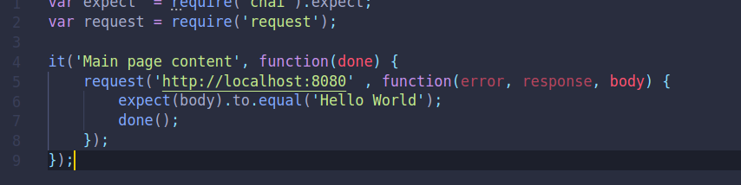
Node.js Testing Frameworks
install the request module like this npm install request chai –save-dev
Create a test folder with a app.test.js file inside the test folder, The code that should be in the ‘app.test.js’ file. This is unit test using Mocha and Chai.
Write the code to test your backend endpoints like this
Use Chai to write the actual code that will be used to execute the test.
Use the it() function to describe the actual test

Slide 7
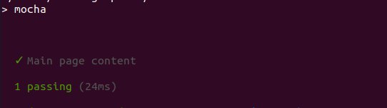
Node.js Testing Frameworks
run npm test
See the output of your tests

Slide 8
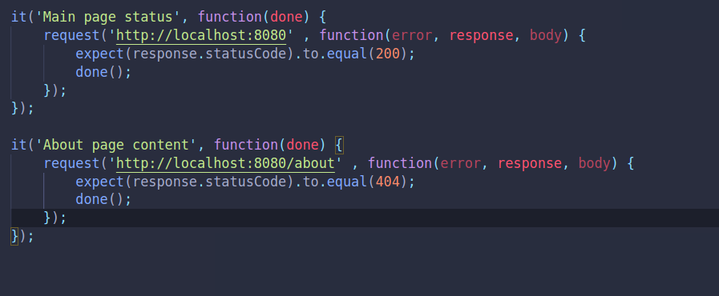
Node.js Testing Frameworks
Write more test scripts in your test file to test different end points. See screenshot below on how to test for end points.

Slide 9
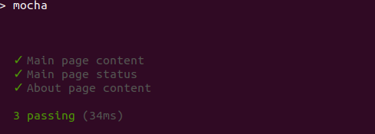
Node.js Testing Frameworks
Now run npm test to see the updated tests in your terminal.
We can fail one test on purpose to see the different output, See example with about end point for this example ...

Slide 10
Node.js Testing Frameworks
let expect = require('chai').expect;
let request = require('request');
describe('Status and content', function() {
describe ('Main page', function() {
it('status', function(done){
request('http://localhost:8080/', function(error, response, body) {
expect(response.statusCode).to.equal(200);
done();
});
});
it('content', function(done) {
request('http://localhost:8080/' , function(error, response, body) {
expect(body).to.equal('Hello World');
done();
});
});
});
describe ('About page', function() {
it('status', function(done){
request('http://localhost:8080/about', function(error, response, body) {
expect(response.statusCode).to.equal(404);
done();
});
});
});
});
You can also group statements and tests together like this:
Notes:
Note: This code example uses the request package which allows you to test HTTP requests by making HTTP calls. To use this package first install it by typing npm install request --save in the command line interface.

Slide 11
Node.js Testing Frameworks
The assert() module compares two values. If the two values aren’t equal, an error is thrown and the code execution is terminated.
let assert = require('assert'); assert(5 > 7);

Slide 12
Resources
Testing a REST API in Node JS with Express using Mocha and Chai

